Slide 1


ARTIFICAL INTELLIGENCE

Slide 2
PROBLEM STATEMENT:
The process of reviewing and evaluating resumes for job applications is often time-consuming and labor-intensive. The task becomes even more complex when organizations receive an overwhelming number of applications. To address these challenges, the problem at hand is to develop an AI-powered resume classification system that can accurately and efficiently analyze resumes, extract relevant information, and categorize them into predefined categories or job roles.

Slide 3
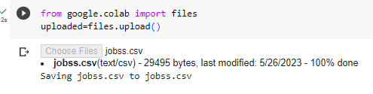
UPLOADING DATA SET:
Uploading dataset on colab

Slide 4


READING DATASET:
We imported Pandas library to read dataset. Pandas provides the read_csv() and other functions to import data from different file formats. These functions load data into Pandas' primary data structure,dataframe

Slide 5
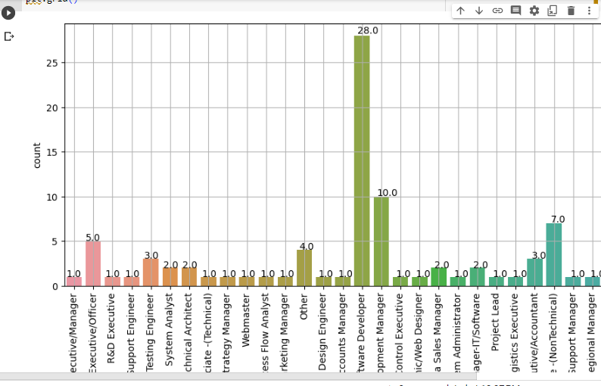
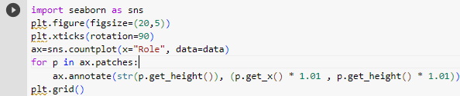
Bar graph:

Slide 6
ONE HOT ENCODING
The purpose of one-hot encoding is to represent categorical variables as binary vectors, enabling machine learning algorithms to effectively interpret and utilize these variables.
Each binary category becomes a new binary feature column. For each data entry, only one of the feature columns will have a value of 1, indicating the presence of that category, while all other columns will be filled with 0s.
It makes it compatible with a wide range of algorithms, such as logistic regression, decision trees, and neural networks.

Slide 7
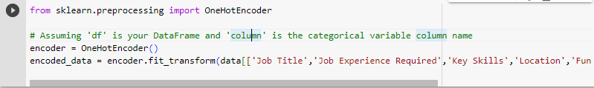
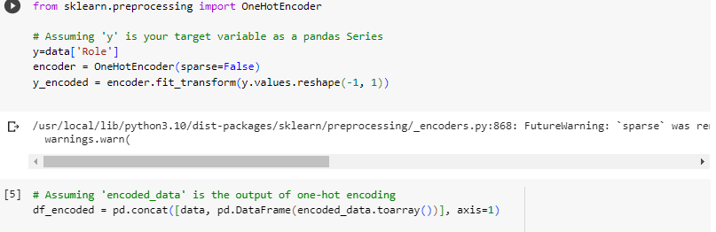

Slide 8
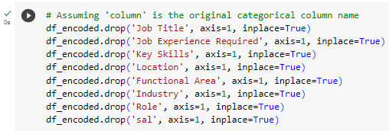
DROP ORIGNAL COLUMNS
Remove the original categorical column from the DataFrame since it has been replaced with the encoded columns.

Slide 9

ASSIGNING X&Y VARIABLES
X represents the input features used to train a machine learning model. In our model x is equal to df_encoded (data frame obtained after hot encoding).
Y represents the target variable. It contains the values that we want the model to predict or estimate. In our model ‘Role’ coloumn is one which we want to predict so it is hot encoded and stored in y.

Slide 10
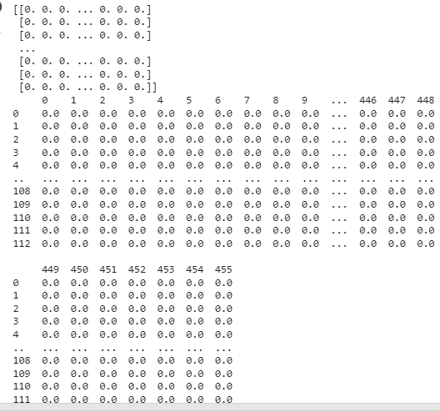
HOT ENCODED VALUES

Slide 11
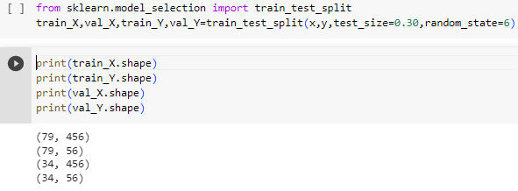
TRAINING MODEL:

Slide 12
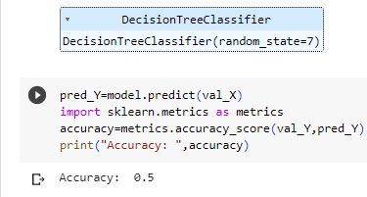
DECISION TREE CLASSIFIER
It is a type of supervised learning algorithm that builds a tree-like model to make predictions based on a set of input features.

Slide 13
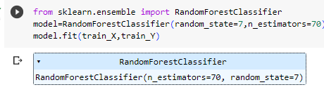
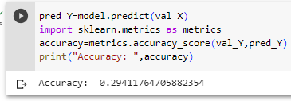
RANDOM FOREST CLASSIFIER
A random forest algorithm works by creating multiple decision trees, each of which is based on a random subset of the data.

Slide 14
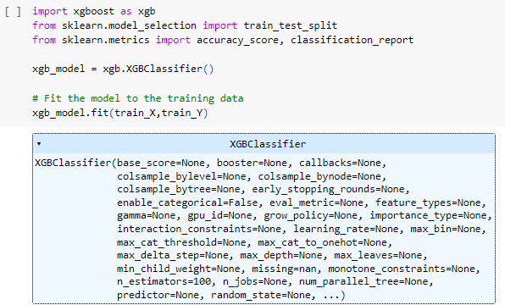
XGB CLASSIFIER

Slide 15
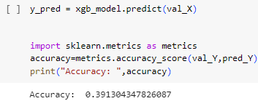
ACCURACY SCORE OF XGB CLASSIFIER

Slide 16
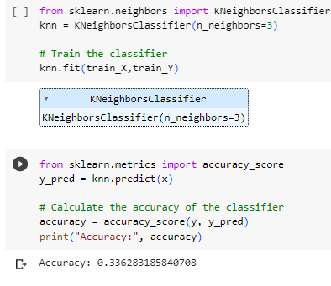
KNN CLASSIFIER

Slide 17
Model Evaluation/Performance
By using decision tree classifier accuracy is 0.5
Random Forest Classifier gives accuracy 0.29 with random state 7
XGB Classifier gives accuracy 0.39
KNN Classifier gives accuracy 0.33
So Decision Tree classifier gives highest accuracy 0.5.

Slide 18
CONCLUSIONS DRAWN AFTER READING RESEARCH PAPERS
Feature engineering plays a crucial role in resume prediction. Extracting meaningful features from resumes, such as educational background, work experience, skills.
In conclusion, research papers on resume prediction using machine learning demonstrate the effectiveness of various algorithms such as neural networks, support vector machines (SVM), and random forests, have been successfully employed in resume prediction tasks. These algorithms can effectively process and analyze large amounts of data to identify relevant information and make accurate predictions.

Slide 19
CONCLUSION:
AI can automate certain aspects of the hiring process, human involvement and judgment are still crucial in making final decisions. AI can help list out candidates and highlight potential matches. The accuracy and effectiveness of resume prediction models heavily rely on the quality and diversity of the training data set. AI can help humans the hiring process. By focusing on objective criteria and qualifications outlined in the resumes. This promotes fairness and increases the chances of finding the best candidate based on merit.

